Slide 1
GMR Institute of Technology

Slide 2
A REVIEW ON
RESTAURENT BILLING SYSTEM

Slide 3
ABSTRACT
It is very important that such an organization should have an efficient internally computerized system to handle and maintain all the records involving the.
Therefore we decided that we should develop a system around this requirement which will increase the efficiency of the maintenance of the records.
We planned to overcome this weakness by developing a computerized system facilitates all the requirements expected by the restaurant .

Slide 4
cont
In this project we were able to overcome almost all the weakness which were at the manual system by adding up more residential characteristics .We were finally able to produce a computerized system that could make a big difference in the restaurant sector

Slide 5
OBJECTIVE
Now a days, many restaurants manage their business by manual especially take customer ordering.
In traditional booking system, a customer has to go to restaurant or make a phone call in order to get his meal reserved .
Today restaurant waiter takes the customer ordering by manual system with using paper. Customer does some formal conservation like hello, hi, etc .Than he demands for today’s menu and do some discussion over menu items then he orders.

Slide 6
cont
It takes 5 to 10 minutes to book the order and waiter book the order on paper so there is probability of lost and duplicates customer information.

Slide 7
PURPOSE
Initial problem is that the customer has to get connected over the phone, it would be harder if the restaurant is very popular and busy.
Sometimes, waiter information and customer information is important is important to restaurant administrator for reference in the future. The chances of committing mistakes at the restaurant side in providing a menu list for a specific time would be more.
So by using this we can book the order from the restaurant itself

Slide 8
INTRODUCTION
The Restaurant Billing Management system aims to make simpler a staff’s interaction with the various modules of the Restaurant and ease the process of acquiring information and providing services.
The system can be accessed by the admin and customers. It will also cutting the operational costs of the hotel.
We have designed this project in java as it provides some fantastic features such as inheritance, polymorphism,etc The project can be run on any platform as java is platform independent. Java also provides code reusability .It provides high security by providing step by step security

Slide 9
REQUIREMENTS
SOFTWARE REQUIREMENTS
JAVA SE 11(18.9LTS)
OS(WINDOWS)
HARDWARE REQUIREMENTS
RAM
PROCESSOR OF HIGH SPEED

Slide 10
SCOPE
As the number of hotels and restaurant are growing everyday our project can increase the business of it by
Giving comfort to the customer
This project can be adapted easily by all the management

Slide 11
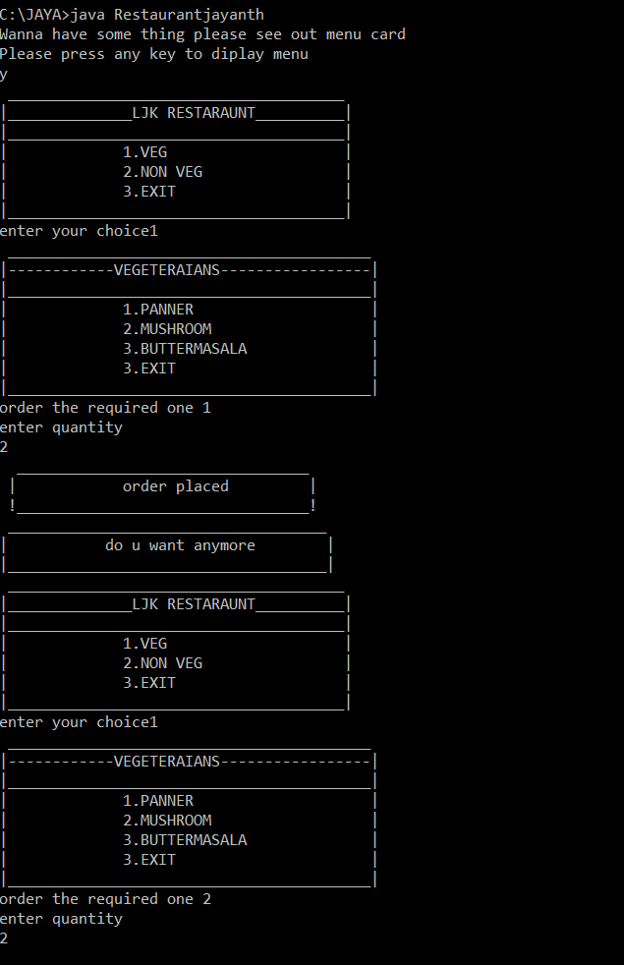

Slide 12
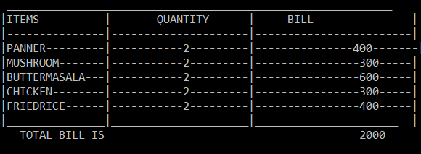

Slide 13
CONCLUSION
. This system is able to store billing records securely and retrieve the records whenever needed easily. Data entering of customers
. Customers, restaurant records and employees are interconnected in order to maintain the accuracy of the system .This system can also be further improved adding many other features and including the other systems as well.
Finally we believe that we able to launch an effective computerized system to the restaurant causing the restaurant to perform well in the future regarding the billing and restaurant records

Slide 14
THANK YOU

